Slide 1
University Grade and Attendance Tracker
JAVA PROJECT
92%
ATTENDANCE
A+
TEAM
GUIDE
A
Thota V Harsha Vardhan 2620030071
S. Raja Manideep 2620030406
Dr. K. Sreeram Murthy
B
16-10-2026
C

Slide 2




Abstract
PROJECT
University Grade and Attendance Tracker
Student records
Attendance
Registers students and courses with roll numbers.
Marks attendance and calculates the percentage.
A Java application that records student attendance and marks, calculates grades and generates a readable report.
TECHNOLOGY
Java
OOP
Collections
Marks & grades
Report export
Records marks and assigns a grade automatically.
Searches records and saves a report as a text file.
Streams
java.nio.file

Slide 3

Understanding Problem Statement
PROBLEM
Manual attendance registers and mark sheets are slow, repetitive and error-prone.
Attendance entries may be missed or recorded inconsistently.
Calculating attendance percentage and grades by hand is tedious.
Students falling short of the minimum attendance may go unnoticed.
OBJECTIVES
1
2
3
4
Record attendance and marks for every student.
Calculate attendance percentage and grade automatically.
Flag students below the attendance requirement.
Demonstrate Java concepts through a practical project.

Slide 4

CO 1 Topics
1
Variables and data types
2
Scanner
store roll numbers, marks and attendance counts.
accepts attendance and marks input from the console.
COURSE OUTCOME
1
1
3
Operators
4
Formatted output
calculate the attendance percentage and average marks.
presents student details and results clearly.
PROJECT EXAMPLE
A student who attends 36 of 40 classes has 90% attendance.
Java Foundations

Slide 5

CO 2 Topics
1
if-else statements
2
switch
assign a grade from the marks range and check attendance.
selects the operation from the main menu.
COURSE OUTCOME
2
2
3
while loops
4
Exception handling
keep the menu active until the user exits.
displays useful messages for invalid marks or attendance.
PROJECT EXAMPLE
A student below the required attendance is flagged as short.
Control Flow

Slide 6

CO 3 Topics
1
Methods
2
Core methods
divide the program into reusable tasks.
markAttendance(), addMarks(), calculateGrade() and showReport().
COURSE OUTCOME
3
3
3
Lists
4
Loops and search
hold student, attendance and marks records.
locate a student by roll number.
BENEFIT
Modular methods make the program easier to test and maintain.
Methods, Arrays and Searching

Slide 7

CO 4 Topics
1
Student and Course
2
Encapsulation
are classes; each student/course is an object.
protects student fields using private variables.
COURSE OUTCOME
4
4
3
Reportable interface
4
Constructors
defines a common printReport() operation.
initialise student data and course details.
5
Exceptions
Object-Oriented Programming
handle invalid marks, duplicate roll numbers and missing students.

Slide 8

CO 5 Topics
1
Strings
2
String formatting
store student names, roll numbers and course codes.
creates readable report rows.
COURSE OUTCOME
5
5
3
Path
4
Files.createDirectories()
represents the location of the report file.
creates the reports folder.
PROJECT EXAMPLE
report_101.txt contains attendance and grade details.
Strings and File Handling
5
Files.write()
saves the report as a .txt file.

Slide 9

CO 6 Topics
1
List
2
Predicate
stores multiple students and their records.
checks whether attendance is below the required level.
COURSE OUTCOME
6
6
3
Streams
4
Lambdas and method references
filter student records.
simplify processing.
PROJECT EXAMPLE
Search and display only students with low attendance.
5
Collectors
Collections, Lambdas and Streams
organise filtered results into a list.

Slide 10



Conclusion
The Grade and Attendance Tracker shows how Java concepts work together in one application.
Organised
Student records are organised using classes and collections.
Automatic results
Attendance percentage and grades are calculated automatically.
FUTURE SCOPE
Database storage
GUI / web interface
Email alerts
Charts and PDF export
NOTE
This is an educational prototype, not an official university system.
Validated
Validation prevents invalid marks and attendance values.
Readable output
File handling saves a readable report.

Slide 11
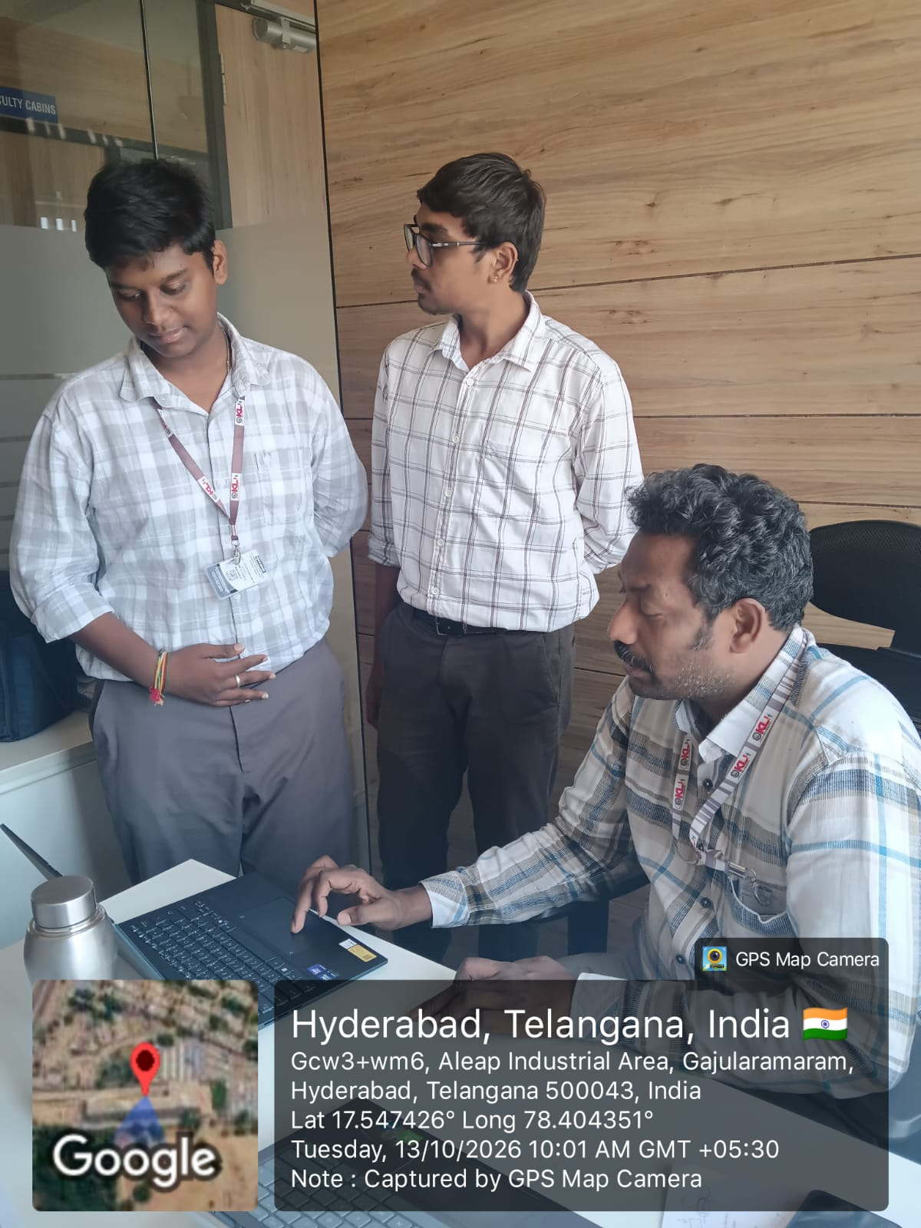

Geo Tag Photo and GitHub Link
GITHUB REPOSITORY LINK
Project source code on GitHub:
https://github.com/srajamanideep-droid/KLHB-FED-26-15-22University-Grade-Attendance-Tracker
University Grade and Attendance Tracker – Java project repository.
GEO-TAGGED PROJECT PHOTO
Captured by GPS Map Camera at KL University, Aleap Industrial Area, Hyderabad on 13/10/2026.

